Slide 1
Cyberbullying Civic Action Project (C.A.P.)
Presented By
Boys & Girls Club After School Zone
At Robinswood Middle School

Slide 2
We are the C.A.P.
☞Advisors: Nerlie and Gabrielle
☞Group Leads: Kevin C. (Research) and Alenis (Art)
☞Art: Nahanka, Nilisa-marie, and Brenda
☞Research: Kevin G., Shoodlyne, Jada, and Justice

Slide 3
THE ISSUE:
☞Cyberbullying has become a concerning matter in schools around Orange County because there has been an increase in students using social media platforms to harass other students.

Slide 4
THE SUPPORTERS:
“My role is to stop bullying and teach students the right way to communicate with others to make positive relationships.” -Ms. Jefferson (Principal of Robinswood MS)
“Cyberbullying is a very cowardly method of negative expression. Love yourself so you can treat others better.”- Mr. Smith (C.A.P. sponsor).
[online]”...Name calling might lead to [negative] reactions...”-Mr. Milton. (SAFE Coordinator)

Slide 5
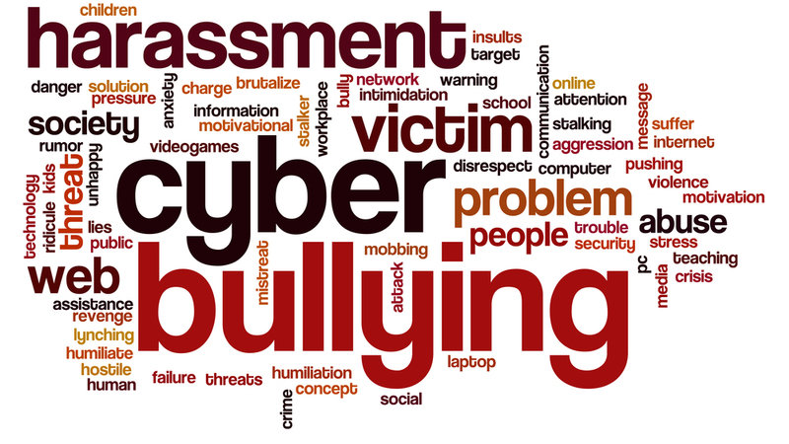
The Policy:
OCPS district guidelines police the use of social media by monitoring online communications on its network and affiliated websites and foster the “See Something, Say Something” adage to students. We propose our support to help strengthen the existing awareness about the causes, effects, and the need for prevention regarding the inappropriate use of social media to avert these acts of cyberbullying.
Pic from Change.Org
Notes:
The school board believes that all students and employees are entitled to a safe, equitable, and harassment-free school experience. Substantiated allegations of bullying, harassment, or discrimination will not be tolerated and shall be just cause for disciplinary action. Any students who alleges bullying or harassment by another student may use the school’s students grievance procedure or may complain directly to the principal or designee.
https://twitter.com/ocpsnews/status/968924154190843904?lang=en
(The link to the “See Something, Say Something” from OCPS News
OCPS Code Of Conduct:
https://www.ocps.net/UserFiles/Servers/Server_54619/File/Frequently%20Updated%20Documents/Code%20of%20Conduct.pdf

Slide 6
Cyberbullying Statistics
According to the 2017 Pew Research Center study on online harassment noted that around 40% of Americans have experienced online harassment personally, while around 62% of Americans already consider cyberbullying to be a major problem in our society. (From the Journal, “Cyberbullying Beyond 2018”)
Pic from Pinterest
Notes:
The school board believes that all students and employees are entitled to a safe, equitable, and harassment-free school experience. Substantiated allegations of bullying, harassment, or discrimination will not be tolerated and shall be just cause for disciplinary action. Any students who alleges bullying or harassment by another student may use the school’s students grievance procedure or may complain directly to the principal or designee.
https://twitter.com/ocpsnews/status/968924154190843904?lang=en
(The link to the “See Something, Say Something” from OCPS News
OCPS Code Of Conduct:
https://www.ocps.net/UserFiles/Servers/Server_54619/File/Frequently%20Updated%20Documents/Code%20of%20Conduct.pdf
Websites: The Pew Research Center: http://www.pewresearch.org/about/
The Journal article Cyberbullying Beyond 2018: https://uisjournal.com/features/2018/04/14/cyberbullying-beyond-2018/

Slide 7
Cyberbullying Statistics
According to the Cyberbullying Research Center’s collected data from 2004-2016, the average offender rate between sampled American middle and high schoolers was about 16%, but the victim rate was near 28%.
One could infer from these findings that it is almost twice as likely to be a cyberbullying victim than an offender.
Pic from Change.Org
Notes:
Website for this data: https://cyberbullying.org/summary-of-our-cyberbullying-research

Slide 8
Cyberbullying Stats (continued)
Currently, there are no federal laws against any type of bullying according to StopBullying.gov.
Florida State Statute 1006.147 sections c and d makes cyberbullying in this state’s schools illegal; however, schools are not required to monitor outside of their network or devices.
Pic from Pinterest
Notes:
Federal Laws about Bullying: StopBullying.gov section site: https://www.stopbullying.gov/laws/federal/index.html
Link to statute: http://www.leg.state.fl.us/statutes/index.cfm?App_mode=Display_Statute&URL=1000-1099/1006/Sections/1006.147.html

Slide 9
Our PSA
From Digicular.com
Notes:
Thanks to Ms. J. Stewart for encouraging the edit of this video!

Slide 10
C.A.P Impact - Why?
When asked about why we joined the C.A.P project there are numerous reasons. For example, we believe that bullying is a big problem since most of us have been bullied. We also deduce that cyberbullying causes depression which can affect self-expression. On the other hand, we can make a change by promoting a safe environment for ourselves and our peers while online.
From Tiny Buddha

Slide 11
C.A.P - Proposal
We would like to see any changes that would push for awareness of cyberbullying. We have raised awareness of cyberbullying by making posters and reporting to teachers or a trusted adult about cyberbullying in our school. However, we would like to make a bigger difference by proposing a Cyberbullying Awareness Month for our school district, which would promote using more positive sayings about fellow students and staff members on social media.
From Zazzle

Slide 12
Thank You!
?
Any questions?

Slide 13
Resource Websites Used:
OCPS Code of Conduct: https://www.ocps.net/UserFiles/Servers/Server_54619/File/Frequently%20Updated%20Documents/Code%20of%20Conduct.pdf
Pew Research Center: http://www.pewresearch.org/about/
The Journal: https://uisjournal.com/features/2018/04/14/cyberbullying-beyond-2018/
Cyberbullying Research Center: https://cyberbullying.org/summary-of-our-cyberbullying-research
https://www.stopbullying.gov/laws/federal/index.html
http://www.leg.state.fl.us/statutes/index.cfm?App_mode=Display_Statute&URL=1000-1099/1006/Sections/1006.147.html

