Slide 1
Don’t be Depressed, There’s OCPS!
By: Mikayla Jacobs, Aisha Shafaat, Baxley Elliot, Alisia Rivera, Ana Chust, Kyara de Leon, Kiara Pernier, Allison Osiol, Isabelle Lugo, Alexandra Goldstein

Slide 2
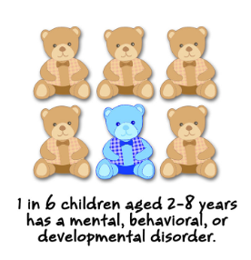
CAP ISSUE INTRODUCTION-At the National Level
(According to the CDC’s National Youth Risk Behavioral Survey)
Mental health is becoming more and more important in the lives of children across America today.
7.4% of children ages 3-17 years (approximately 4.5 million) have been diagnosed with a behavior problem.
Today, 9.4% of children ages 2-17 years (approximately 6.1 million) have received an ADHD diagnosis.

Slide 3
CAP ISSUE INTRODUCTION-At the National Level
(According to the CDC’s National Youth Risk Behavioral Survey)
7.1% of children ages 3-17 years (approximately 4.4 million) have been diagnosed with anxiety.
3.2% of children ages 3-17 years (approximately 1.9 million) have been diagnosed with depression according to figures released by the CDC.

Slide 4
2.7%
2.3%

Slide 5
CAP
ISSUE INTRODUCTION
Sandy Hook Elementary, Columbine High & Parkland
What do each of these tragedies have in common with one another?
There is a strong need to help students who suffer from mental health issues during the school day as well as after school.
This is where Orange County Public Schools (OCPS) has shined through and is providing this help now more than ever before.

Slide 6
CAP Issue Introduction
Orange County Public Schools is a district leader in our state when it comes to providing help to students who may suffer from mental illness issues in their district.
They provide services during the school day, as well as after school for students to seek help if they need it.

Slide 7
CAP Issue Introduction
During the school day, students can receive help from their school’s respective guidance counselors as well as their SAFE coordinator.
After school, students may contact the National Suicide Prevention Hotline, the Crisis Textline, or The Mobile Crisis Unit.

Slide 8
CAP Issue Introduction
According to the Orange County Public Schools Guidance and Mental Health Services website, they have 13 Licensed Mental Health Counselors to support their schools.

Slide 9
CAP Issue Introduction
Their team is comprised of 10 counselors assigned to each of the learning communities, 2 counselors who provide oversight to their SEDNET program and 1 counselor who provides support to their alternative schools and schools needing additional supports.

Slide 10
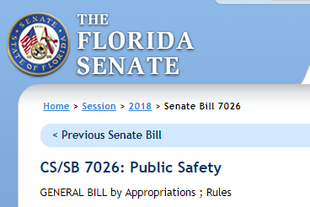
State Support For OCPS To Help With Students
Who May Suffer From Mental Illness
During the 2018-2019 school year, OCPS received $4.7 million in additional funding to help students who suffer from mental health from Senate Bill HB 7026.

Slide 11
State Support For OCPS To Help With Students
Who May Suffer From Mental Illness
According to a February 2019 News Channel 6 news article, OCPS Student Services Coordinator Mary Bridges was quoted in the article talking about how the additional funds has helped the district by saying, “We see that any time a student is in crisis or in distress, they are being attended to."

Slide 12
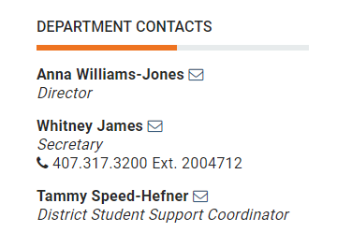
Additional OCPS Support- Anna Williams-Jones Director of Guidance and Mental Health Services for OCPS
Ms. Williams-Jones has also been instrumental in helping us with our project.
She has informed us that on May 9th, OCPS is making a district wide proclamation for National Children’s Mental Health Awareness Day.

Slide 13
Additional OCPS Support- Anna Williams-Jones Director of Guidance and Mental Health Services for OCPS
Additionally, the district has implemented a safe spaces campaign for middle and high school campuses this year so each student will be able to identify a trusted adult on campus if they are in a crisis or have a concern they need to discuss.

Slide 14
CAP Policy Connection
So why are we here tonight you might ask? The reason we are here is to discuss how we can assist Orange County Public Schools in creating mental health posters that can be displayed around all OCPS school campuses.
Currently, OCPS does not have any posters on their campuses with information on how students can receive help from the district during or after school.

Slide 15
CAP Policy Connection
Ms. Williams-Jones has informed us that the district is planning on creating mental health posters next year and we would love to help create them.
During the school day, many of our Hunter’s Creek Middle School Boys & Girls Club members are aware of their schools guidance counselors and SAFE Coordinators.

Slide 16
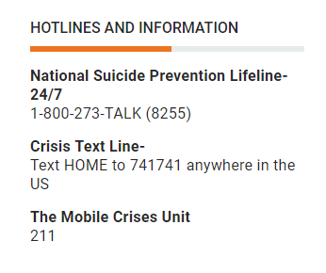
CAP Policy Connection
When it comes to after school help OCPS provides, our group searched the web and were able to locate the after school services OCPS provides students who may suffer from mental illness.
We are able to find this information on the OCPS Guidance and Mental Health Services website

Slide 17
CAP Policy Connection
This made us all wonder, since some of us in our group may be aware of all of the mental health services OCPS provides them during the school day, how many of our Hunter’s Creek Middle School Boys & Girls Club members are also aware of these services provided to them after school as well?

Slide 18
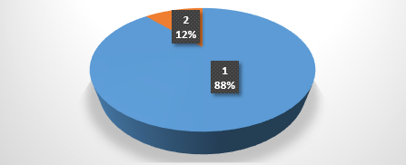
88% of HCMS Boys & Girls Club members who were surveyed are not aware that OCPS provides after school services to students who suffer from mental illness.
12% of HCMS Boys & Girls Club members who were surveyed are aware that OCPS provides after school services to students who suffer from mental illness.
How many Hunter’s Creek Middle School (HCMS) Boys & Girls Club Members Surveyed Know That Orange County Public Schools Provides After School Services For Students Who Suffer From Mental Illness?
CAP Support-Survey

Slide 19
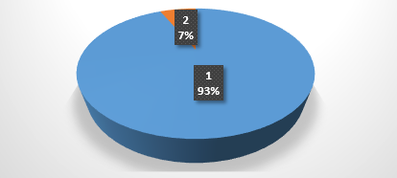
93% of HCMS Boys & Girls Club members who were surveyed feel that OCPS should provide posters with information on how it helps students during the school day as well as after school.
7% of HCMS Boys & Girls members who were surveyed feel that OCPS should not have to provide these posters.
How Many Hunters Creek Middle School (HCMS) Boys & Girls Club Members Surveyed Feel That Orange County Public Schools Should Provide Posters With Information About How It Helps Students During The School Day As Well As After School?
CAP Support-Survey

Slide 20
CAP Support-Local Connection
2011, 2013, 2015 & 2017 OCPS Middle School
Youth Risk Behavior Survey Summary
Closer to home, we wanted to see how students who may be going through their own mental health issues have dealt with their illnesses. Our research led us to the 2011, 2013, 2015 & 2017 Orange County Public Schools Middle School Youth Risk Behavior Surveys conducted by the CDC with help from OCPS.
In 2017, OCPS had 1,734 students complete a survey across 39 OCPS middle schools.

Slide 21
CAP Support-Local Connection
2011, 2013, 2015 & 2017 OCPS Middle School
Youth Risk Behavior Survey Summary
In this survey, we found a couple of statistics that we feel help support our Civics Action Project tonight.
According to the surveys, we found three areas that we would like to discuss.

Slide 25
CAP Public Service Announcement Video
Now Please Enjoy our PSA
https://youtu.be/wdYCeGS8uFo

Slide 26
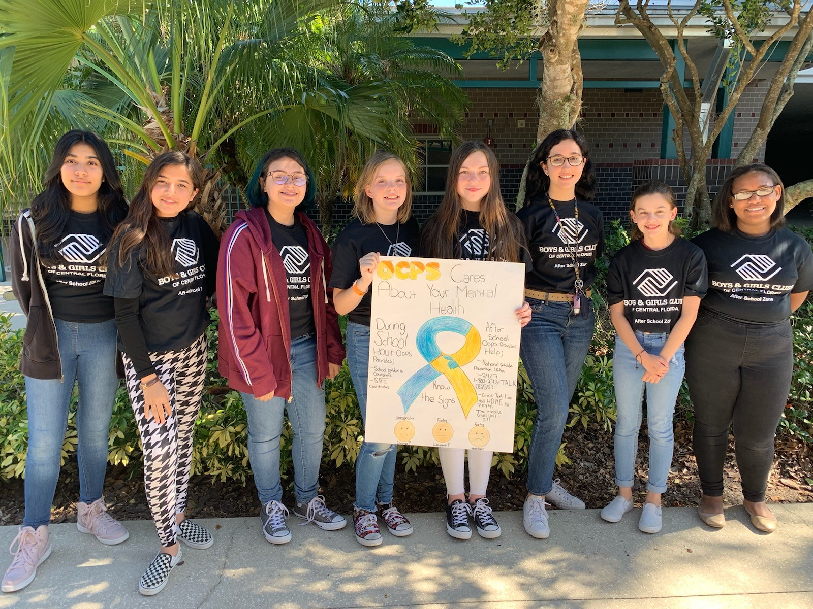
CAP Impact
CAP Impact
CIVICS ACTIONPROJECT
Civics Action Project
CAP Q & A

