Slide 1
Less Waste
=
Less Hunger
Notes:
Introduce team members and then introduce 3801 Wetherbee Rd, Orlando, FL 32824

Slide 2
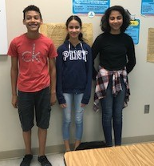
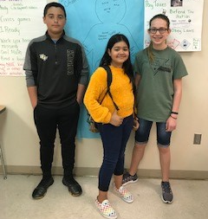
CAP TEAM
Briana Perez-Morales
Denisse Hernandez
Laila Genao
Ricardo Suarez
Jose Fontanez
Jillian Collado
Kalli Hodges
Owen Rodriguez
Notes:
Denisse- “ These are the students who worked on the project”

Slide 3
CAP Issue Introduction
The issue we chose to work on is based on our school cafeteria waste. Our initial observation was that we see students throw away full trays of food after getting their lunch. The reason we chose this problem was based on the fact that we are always hungry, which lead to many ideas on how we can solve this problem.
Notes:
This is Denisse’s page

Slide 4
Civics In Action Supporters
Mrs. Steele (Cafeteria Manager)
Mrs. Lane (CAP Sponsor)
Mrs. Rondon(South Creek Boys and Girls Club Coordinator)
Mr. Brown(School Principal)
Dr. Larsen (SCMS Assistant Principal)
Notes:
Ricardos Page

Slide 5
CAP Policy Connection
We wanted to create a school policy for share tables, to inform students about what rules are in the cafeteria since they are not specific. (Ideas of solutions in upcoming slides). From asking questions, we found out that having a share table is always an option, but they never knew students were interested in having them, until now :)
Notes:
Laila’s Page

Slide 6
SOLUTIONS!
Put up a SHARE TABLE!
* a share table is a table in the cafeteria in which students can place unwanted items from their trays on the table to reduce waste*
Put up posters in the cafeteria to encourage students to contribute to the share table
Put up posters to inform students about rules and policies in the cafeteria
Notes:
Briana’s Page

Slide 7
PSA VIDEO
https://www.youtube.com/watch?v=d-uzP5uvwKA
Enjoy:)
Notes:
Video’s Page

Slide 8
IMPACT OF OUR PROJECT
On March 26, 2019 our share table finally went up for the first time! We already have seen it working. For example, we have seen food in the buckets and students taking food from it. That is the impact we want to see moving forward. We would like to see share tables in other schools, significant drops in money spent for cafeterias, and satisfied students.
Notes:
Jill’s Page

Slide 9
After all of our research we conducted a survey to see how much food our school wastes every day
Now for the Statistics of the survey that we gave out to the students of SCMS :)
Notes:
Denisse’s Page

Slide 10
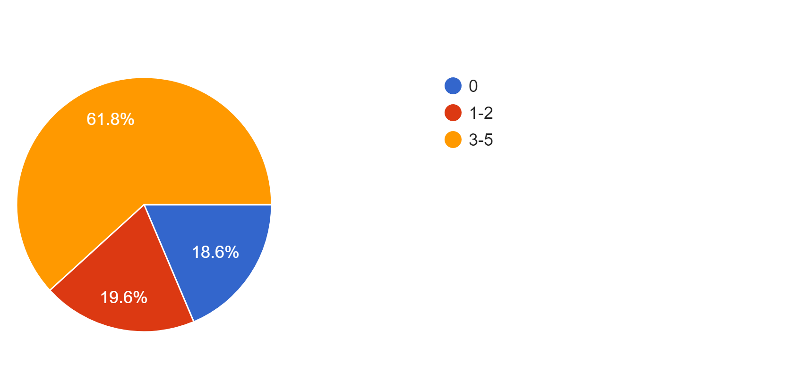
How many days a week do you eat school lunch?
Notes:
denisse

Slide 11
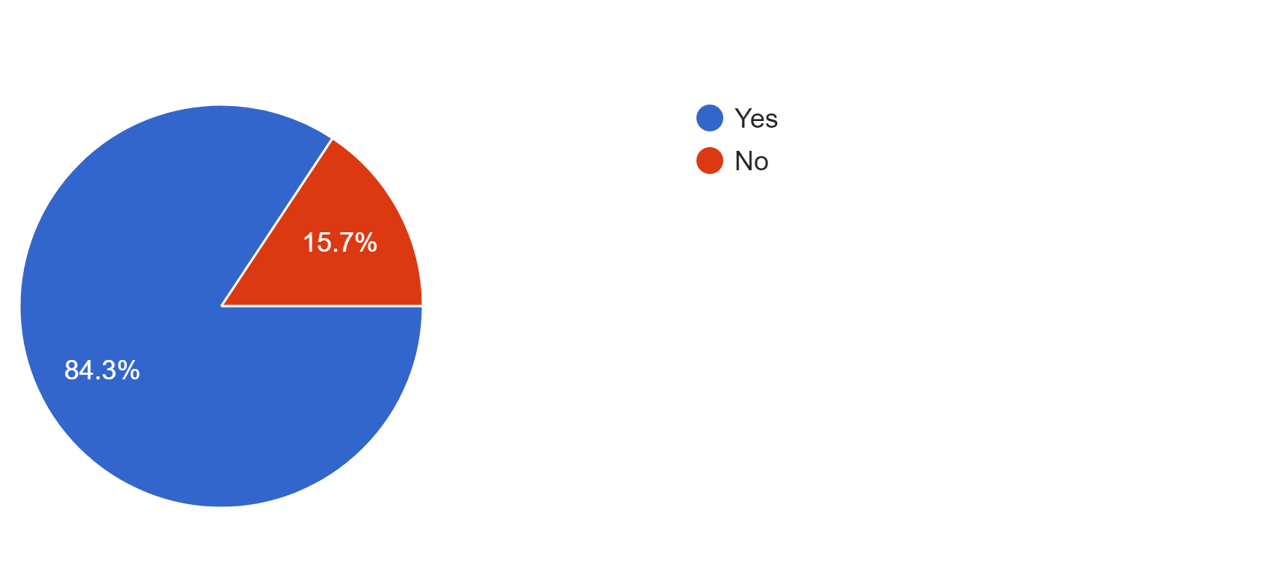
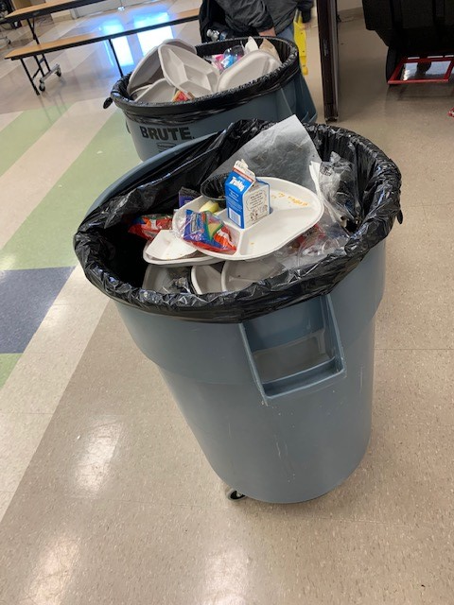
Do you throw away items from the cafeteria?
(Real trash can from SCMS)
Notes:
Laila

Slide 12
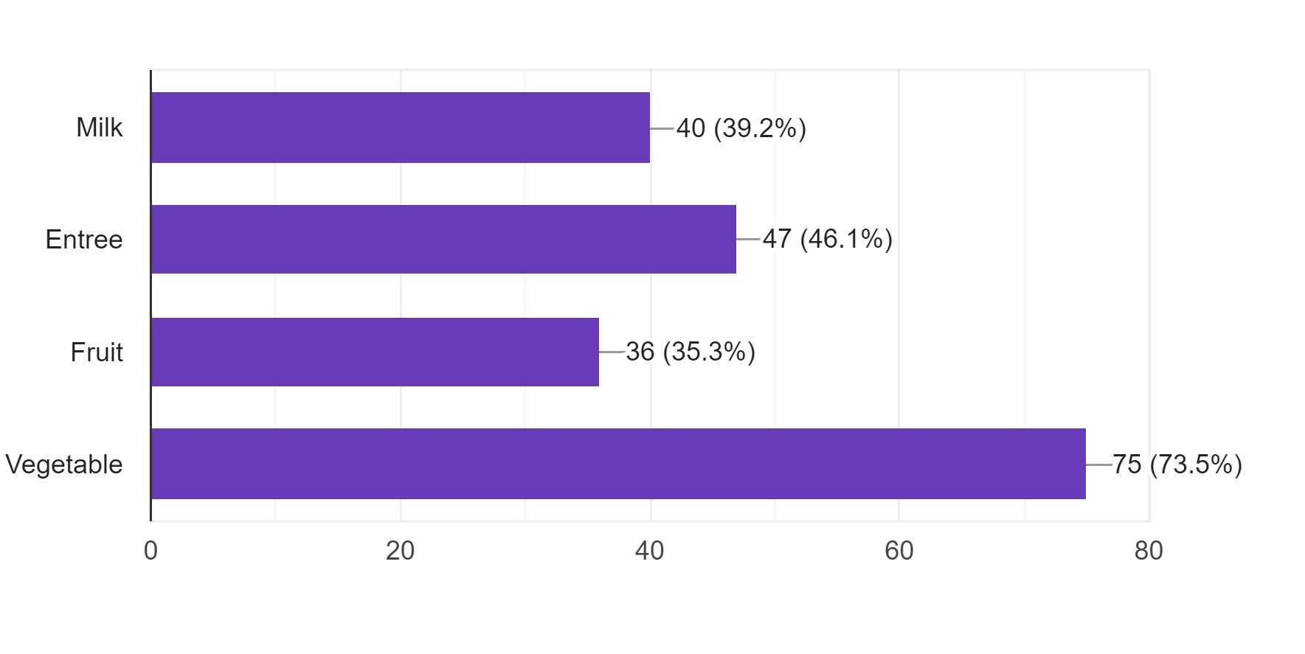
What items do you throw away from your tray?
Notes:
briana

Slide 13
How much money could be saved?
Each carton of milk costs food services $0.20 cents
Approximately 40% of students claimed they throw away their milk at lunch.
We can estimate that is 400 students of SCMS
So, we did the math…
$0.20 times 400 students = $80 a day
$80 a day = $400 a week
$400 times approximately 36 weeks of school = $14,400 per year
Notes:
Briana’s Slide

Slide 14
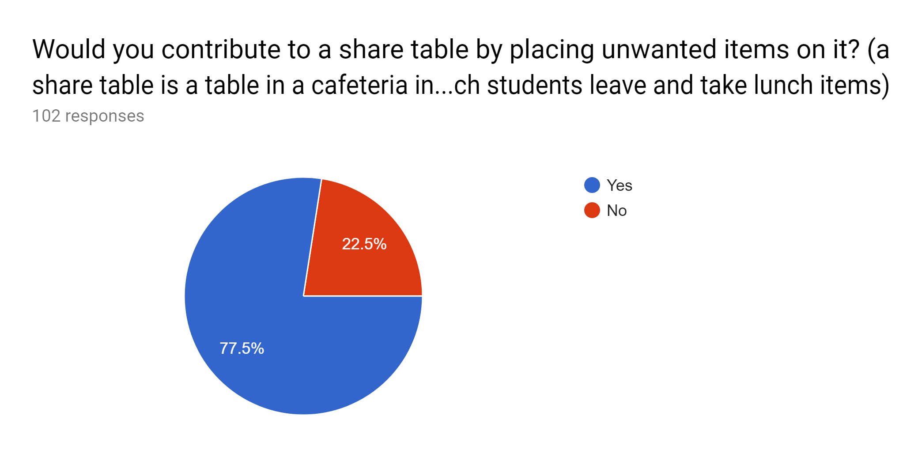
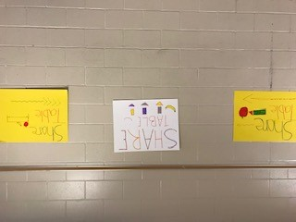
Would you contribute to a share table by placing unwanted items on it?
Notes:
ricardo

Slide 15
NOW TIME FOR THE Q&A
Notes:
Everyone answers

Slide 16
This concludes our presentation.
Thank you for viewing!
Notes:
All of us

