Slide 1
One Small Swing or Ramp, One Giant Leap For Inclusiveness
By: Mackenzie Aquila, Sarah Hedger, Madison McCranie, Kyara De Leon, Alexa Fossi, Ana Chust, Selena Robledo, Angelina Bello, Anthony Perez, Adriana Duarte, Danna Fernandez, Aisha Shafaat

Slide 2
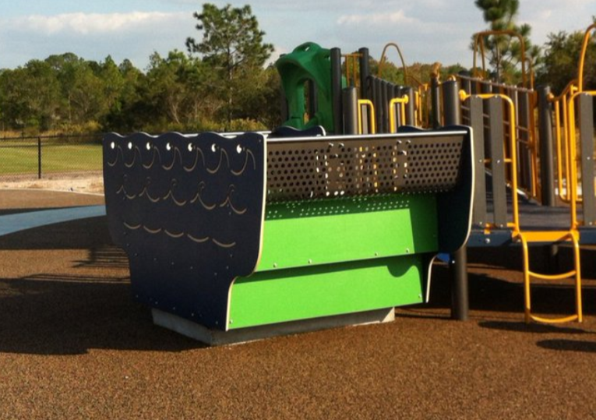
CAP Issue Introduction
Our policy issue centers on the availability of handicap accessible playgrounds in the City of Orlando, Orange County Florida and in Orange County Public Elementary Schools.
At present levels, we would like to see a stronger partnership between our governments and the school system that serves us respectively.

Slide 3
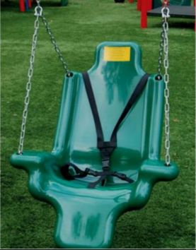
Cost of Swing Without a Wheelchair
We researched prices for handicap accessible swings on a website called Blugrassplaygrounds.com
In general the cost for the swing without the wheelchair in it is $426.

Slide 4
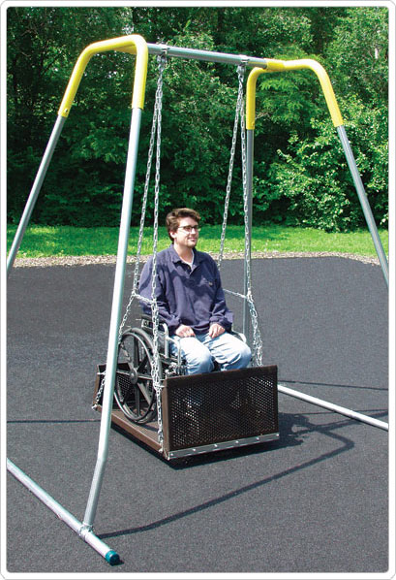
Cost of a New Swing for a Wheelchair
We also researched prices for handicap accessible swings.
In general the cost for the swing with the wheelchair in it is $4,511.00

Slide 5
Cost of a New Ramp
We also researched prices for handicap accessible ramps on a website called:
In general the cost for the ramp with the wheelchair in it is $1,340.45

Slide 6
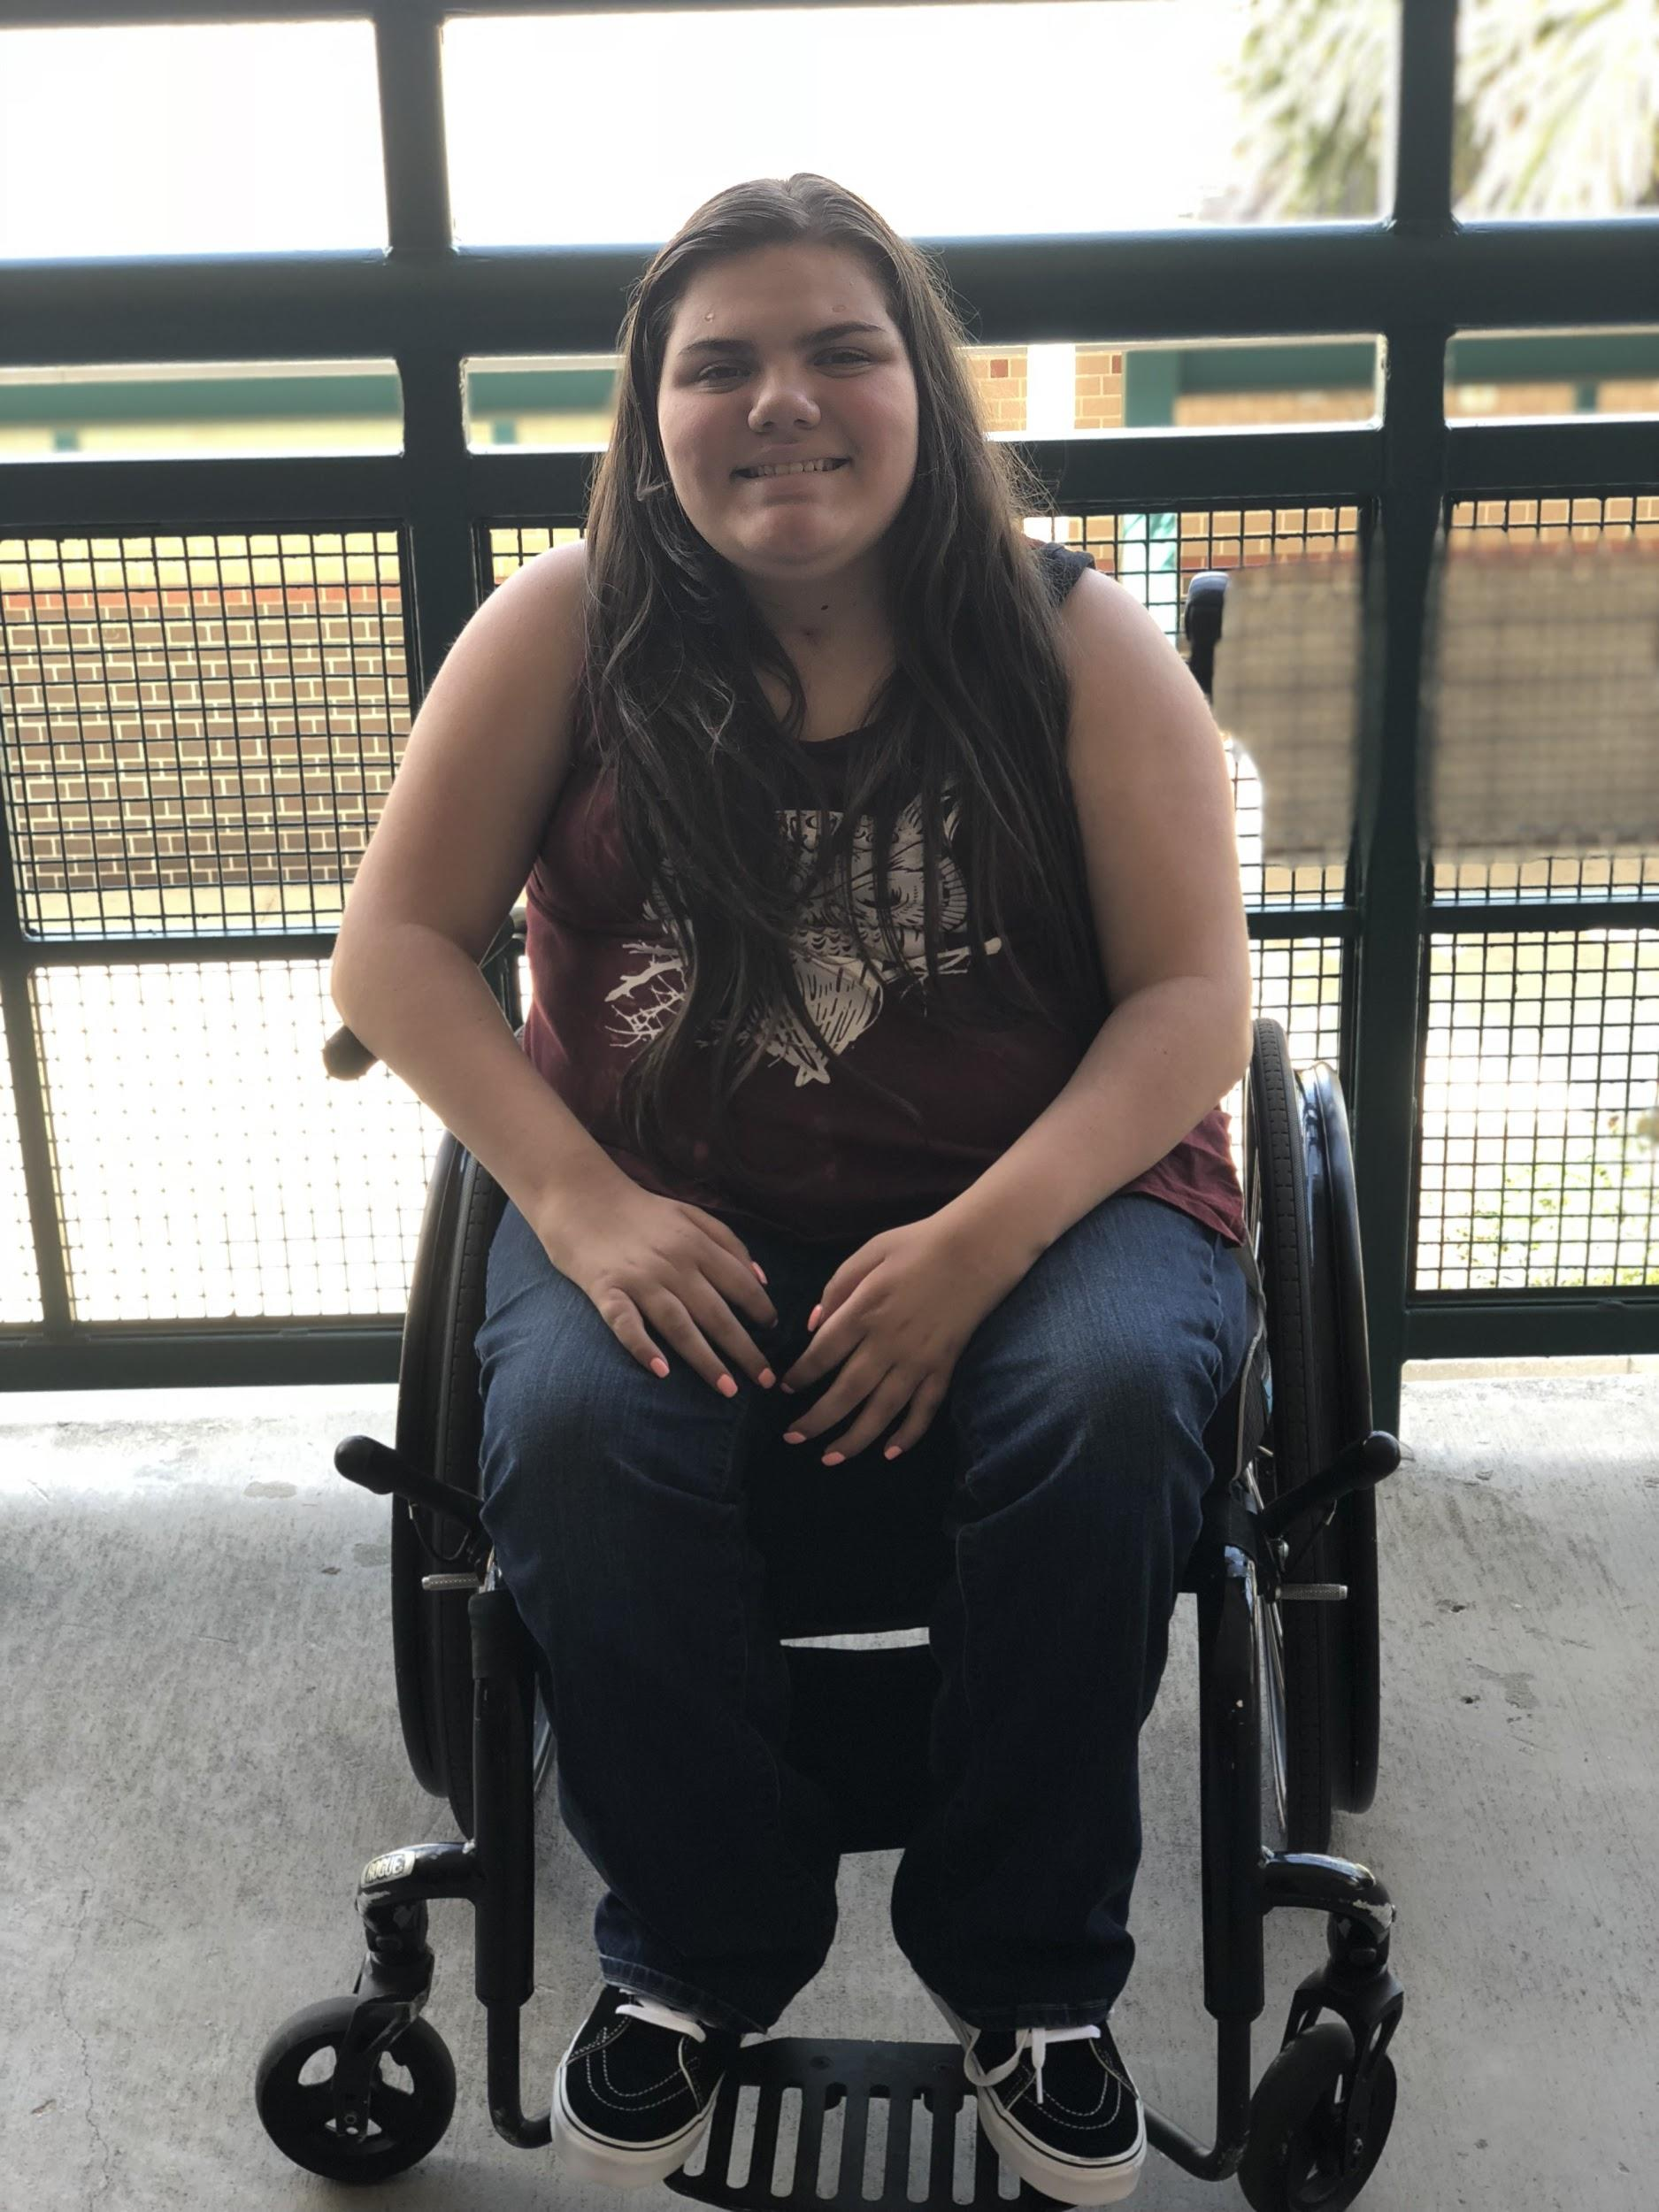
ONE PIECE OF PLAYGROUND EQUIPMENT, ONE PLAYGROUND AT A TIME.
WANTING TO MAKE A DIFFERENCE BY CREATING LIFELONG FRIENDSHIPS
Notes:
Here we are going to include our motto: one ramp or swing, one giant leap for inclusiveness.

Slide 7
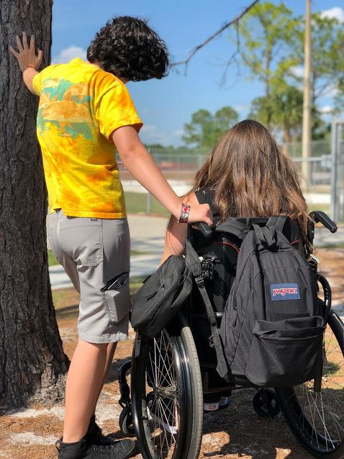
Elementary decisions needed to be made at an earlier age.
I had to make the same decision each day: choose my best friend Mackenzie or hang out with other students?
Notes:
Here Sarah is going to discuss the following: One of the main reasons why we are so passionate about these policy issues can actually be traced back to when Mackenzie and I were in elementary school. When going outside for recess, I would have to make a choice as to whether or not I wanted to play on the playground or stand under a tree with Mackenzie. Picking to play on the park would make me feel guilty about not hanging out with her and this is one of the reasons why I support this Civics Action Project.

Slide 8
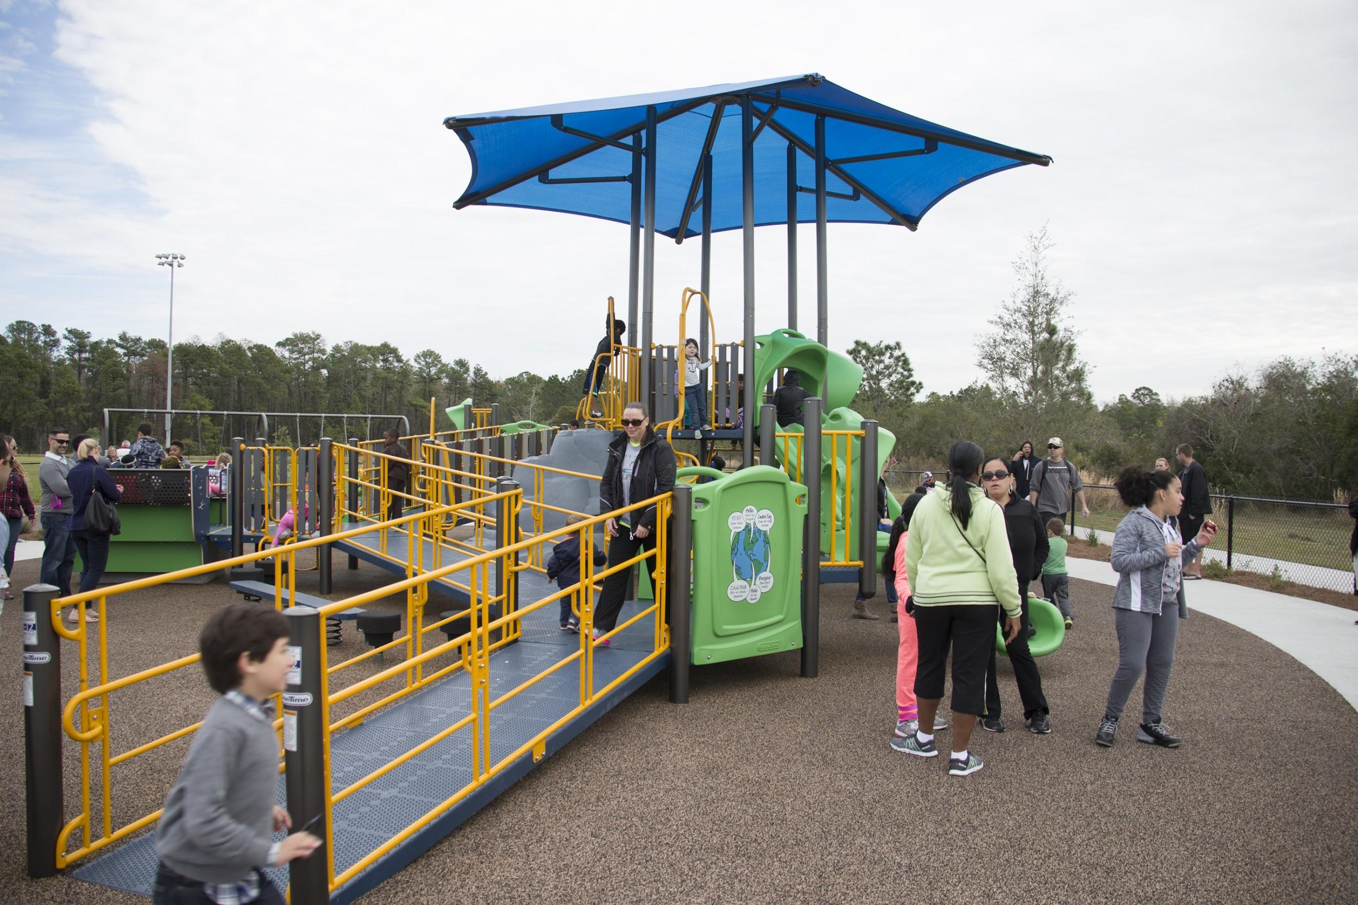
Trust+Partnership=Needs of Our Community Met
Notes:
Our Hunters Creek CAP project would like to focus our building a stronger partnership between the City of Orlando, Orange County’s government and Orange County Public Schools. We feel that strengthening our ties between these three groups and with our CAP team, we can attain a long lasting partnership.

Slide 9
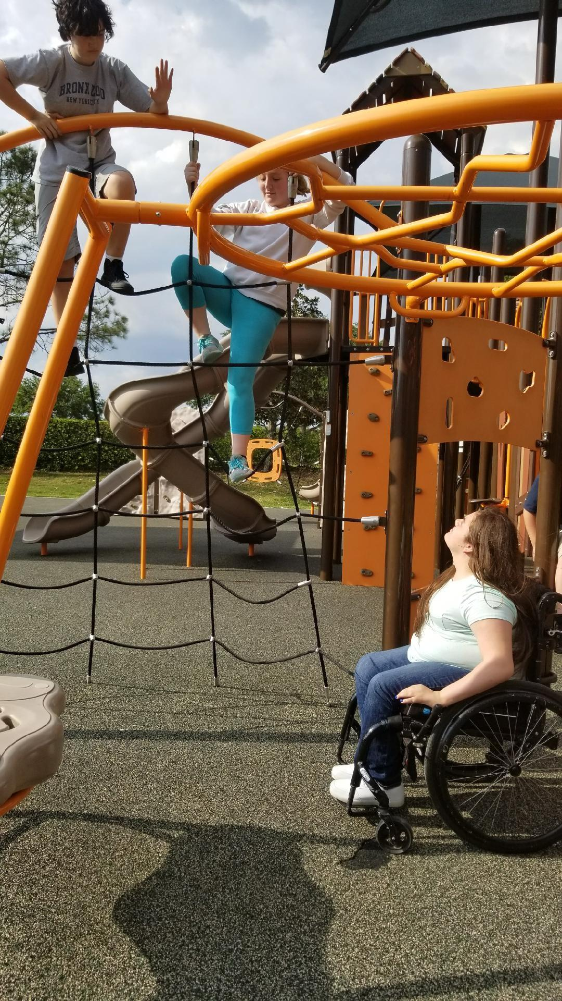
Why are we here?
What are we looking to accomplish?
What type of partnerships are we looking for from you, the leaders of our local governments and our school board
Notes:
How can we work together? We are not asking for you all to kindly spend upwards of $100,000 to $500,000 on a new inclusive playground (which some parks do cost). However, we are simply asking for the governments here tonight and our local school board to begin the process of possibly placing one piece of inclusive playground equipment in more of local parks and elementary schools.

Slide 10
CAP Supporters of Our Project
Rick Hansen Foundation
National Public Radio
Local Support from our Boys & Girls Club After School Zone members
Notes:
According to the Rick Hansen Foundation, he states “Children with disabilities are at higher risk of social isolation. Studies have found that children with disabilities are excluded from play significantly more often than their peers without disabilities.”

Slide 11
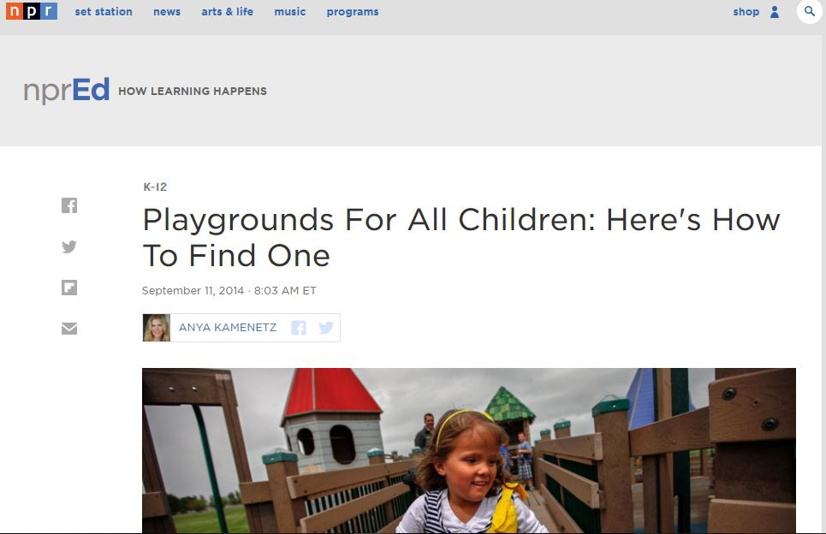
Notes:
In addition, according to a 2014 article by the National Public Radio, there are an estimated 6.4 million children across the United States that have a disability. In the article, they talk to a mother of a child who has a disability. She states “My daughter can't do very much at a typical playground, except watch her older sister play. Playgrounds are a depressing place for us."

Slide 12
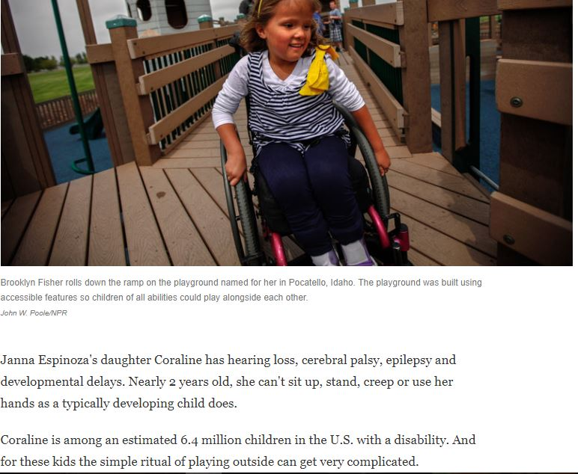
Notes:
In addition, according to a 2014 article by the National Public Radio, there are an estimated 6.4 million children across the United States that have a disability. In the article, they talk to a mother of a child who has a disability. She states “My daughter can't do very much at a typical playground, except watch her older sister play. Playgrounds are a depressing place for us."

Slide 13
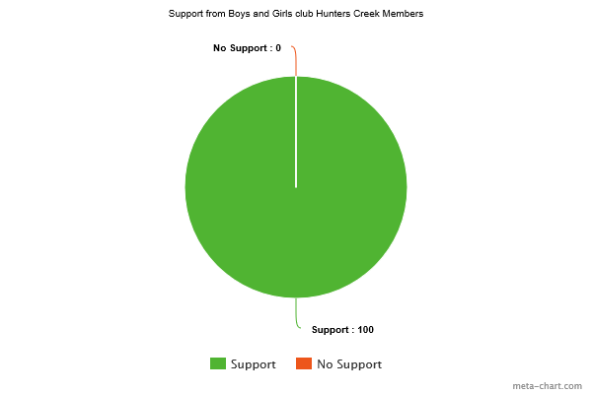
Notes:
We conducted a survey in the Hunter’s Creek Boys & Girls Club After School Zone to see if they thought their parents would pay extra tax dollars for inclusive parks, and we found that 100% of the students said there parents would pay extra tax dollars to see more inclusive parks.

Slide 14
Policy Connection
We examined the Orange County Parks and Rec 2016-2026 Master Plan
We researched their site to see their future plans for providing more inclusive playgrounds.

Slide 15
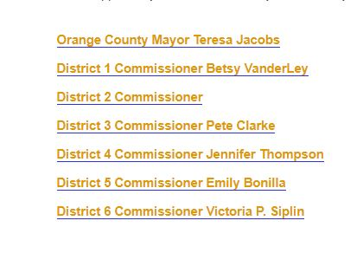
Notes:
We examined their 2016-2026 Orange County Parks-Needs Assessment plan that each county commissioner held with their respective citizens.

Slide 16
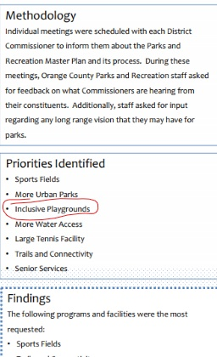
Each commissioner held district meetings with their citizens
7 priorities were identified by the county commissioners, one of which was the need for inclusive playgrounds.
Each commissioner held district meetings with their citizens
7 priorities were identified was inclusive playgrounds.

Slide 17
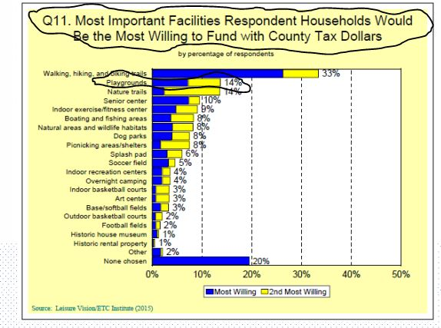
We also looked at Orange County Government’s NEEDS ASSESSMENT -Statistically Valid Survey
In their Survey, adding playgrounds was the 2nd most Important Facilities Respondent Households Would Be the Most Willing to Fund With County Taxpayer Dollars
Notes:
We find this important because we can clearly see that isn’t an issue that the citizens of Orange County would be opposed to paying for.

Slide 18
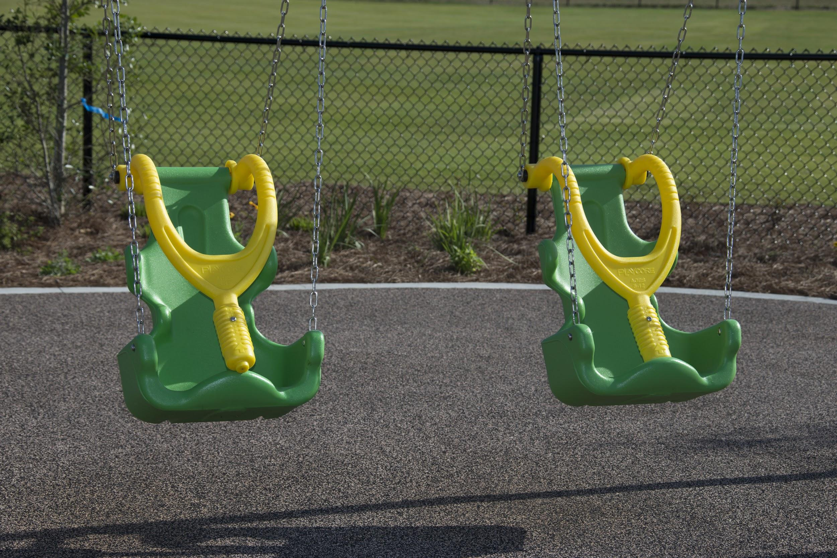
CAP PSA Video
CAP Public Service Announcement (PSA) Video
Now Please Enjoy our PSA
https://youtu.be/pDAZ6Xh0l5c

Slide 19
CAP IMPACT
Currently, the City of Orlando does not have one truly all-inclusive playground within the city limits.
We know the City currently has 52 playgrounds that have principles of inclusive play.
Can the City of Orlando begin the process of creating one of these parks?

Slide 20
CAP IMPACT
Currently, Orange County has two inclusive playgrounds.
We would like to see them add a third park in the county or add inclusive playground equipment to more of their county playgrounds
We would also like to see them add inclusive playground symbols on their Orange County Parks and Recreation Map.

Slide 21
CAP IMPACT
Right now, OCPS has 125 elementary schools
We would like to see OCPS place inclusive playground equipment in some (if not all) of their OCPS elementary schools.

Slide 22
CAP Impact
CIVICS ACTIONPROJECT
IMPACT
Notes:
As we conclude our CAP presentation this evening, we would like to again thank you all for being here and especially giving up your time to hear each of our presentations. We know your time is valuable and we thank you again. My name is Mackenzie Aquila and the reason why we are here tonight is to partly due to what happened to me at the age of one. When I was one got in a car accident and at the age of 5, I got my first wheelchair. Throughout my life, the nearest truly inclusive playground is located 30 minutes from the school I attend. Recently, we are aware that the county has opened up the The Deputy Brandon Coates Park opened on July 30, 2016 which is not to far from where I live. We are very grateful that the county has decided to build this park in our area. We would love to see the county place at least one swing or ramp inside this park if it is at all possible. I would love to see this partnership between my county government and me strengthen because I want to be able to hang out and play with people with disabilities like mine on inclusive playgrounds. This partnership will strengthen because if we add more playground equipment, more disabled kids will play at county parks. This will help future students create more friendships that are stronger and longer.

Slide 23
CAP Q & A

Slide 24
Thank you!

