Slide 1
Helping to Make the Ride to School Safer
Presentation by MWMS CAP Pioneers

Slide 2
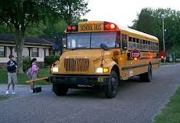
CAP Issue Introduction
Millions of kids take the school bus to and from school daily.
Our issue revolves around ensuring safety as our country’s future gets on and off school buses each and every day.
Why is this important?

Slide 3
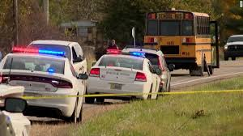
Casualties in School Bus related crashes from 2007-2017
There were 47,000 reported injuries of school bus passengers in the US during this time span.
72 student passengers unfortunately lost their lives in accidents.

Slide 4
Source: https://injuryfacts.nsc.org/motor-vehicle/road-users/school-bus/

Slide 5
Recent examples of school bus casualties
On Halloween last year, 3 young children were struck and killed when walking to their bus in Rochester, Indiana.
Bus had its stop lights flashing and the stop arm was extended.
Closer to home, Cameron Mayhew was killed walking to his bus on June 2nd, 2016 in Fort Myers, FL.
This incident resulted in the passing of the Cameron Mayhew Act as well as other bills aimed at making violations harsher in the state of Florida.
Accidents like these are in danger of happening right here, right now.

Slide 6
MWMS CAP Mission
What can we do?
Our goal is to eliminate these type of accidents by informing of the public policy and problems regarding school buses and student safety.
We think the main method of achieving this goal is by reminding current drivers and informing future drivers in our community.

Slide 7
CAP Supporters
Students
Teachers
Parents
Adults

Slide 8
What will we inform?
Florida Department of Education has specific guidelines on the expectation of the district regarding school buses.
Rule 6A-3.0121 states: The district shall inform parents, guardians, and students at least annually, in writing, of their responsibilities and related district policies [regarding school buses]
We think that policy makers can do a better job in informing all adults of the rules drivers must follow when students are getting on and off school buses during the day.

Slide 9
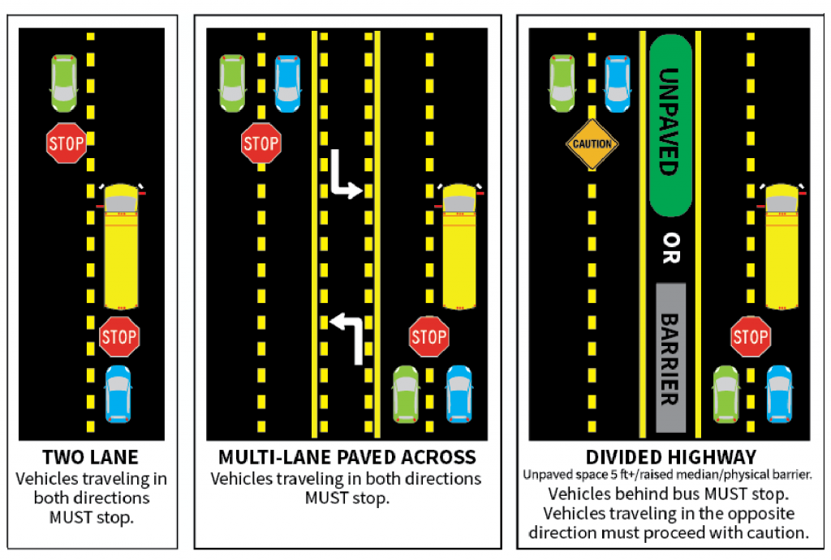
What are the rules?
One of our main goals is to inform citizens of the current policy regarding stop arm violations.
Diagram comes from Florida Highway Safety and Motor Vehicles

Slide 11
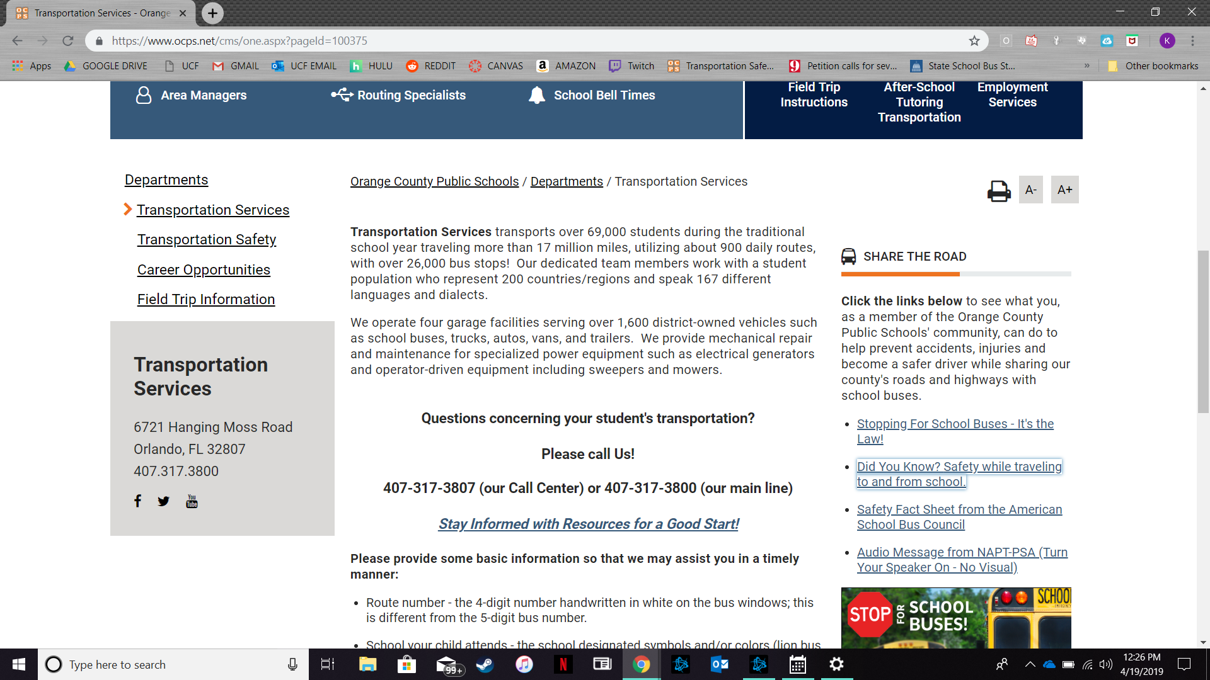
Relating Back to 6A-3.0121
One of the few places this information could be found is on OCPS’ website under “Transportation Safety”.
Found on a link in a column in the margins.
Great, but more can be done!
Source: https://www.ocps.net/cms/one.aspx?pageId=100375

Slide 13
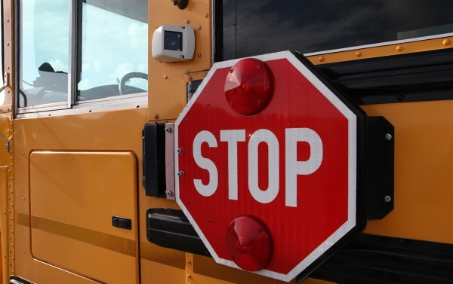
Another Talking Point
Stop Arm Cameras
Already implemented in thousands of school districts.
Authorized by law in 16 states.
Would be able to record and fine those who disobey the law at much greater efficiency than currently.

Slide 14
Stop-Arm Cameras in Florida
Extremely recently, House Bill 849 was filed in the Florida State government.
This would authorize Florida school districts to install cameras on school buses.
We think this would be great because..

Slide 15
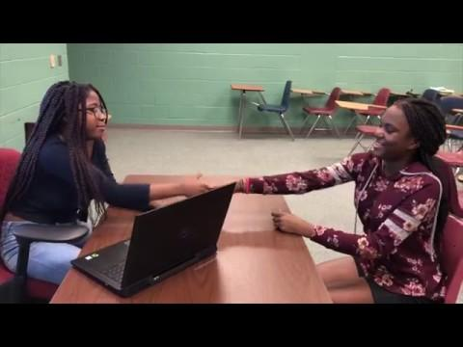
MWMS CAP Public Service Announcement

Slide 16
The Impact We Want to See
Inform
We want to see citizens informed regarding the laws of school bus boarding/disembarking all around.
Includes the general policy and the laws surrounding it.

Slide 17
The Impact We Want to See (continued)
Want to see this figure in more places than just the driver’s handbook.
Also would love to see more knowledge and support of FL-HB 849 by the public.
If we all do our part...

Slide 18
Our future would be in better hands with Central FL maintaining its position as one of the best places to live.
THANK YOU!

